Slide 1

TECHNO INDIA NJR INSTITUTE OF
TECHNOLOGY
PROJECT PRESENTATION

Slide 2
TEAM DETAILS
Name – Chirag Jain Branch - Computer Science Engineering Roll no. – 18ETCCS024
Name – Hardi Jain Branch – Computer Science Engineering Roll No. – 18ETCCS036
Name – Laxmi Kunwar Panwar Branch – Computer Science Engineering Roll No. – 18ETCCS058

Slide 3
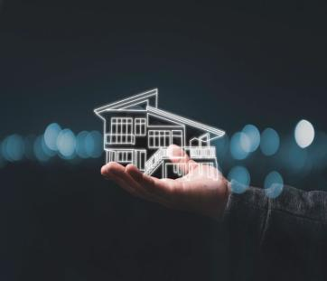
HAMESHOMES.COM (Real-estate Website)
We have developed a website for real estate operations in order to make it more accessible and much organised which solves a number of problems faced by consumers and brokers.
This website provides easy way to find affordable houses and properties.
It also provides easy ways for home insurances.
Site provides online real-estate service committed to helping you make wise and profitable decisions related to buying, selling, renting and leasing of properties, in IOWA.

Slide 4
METHODOLOGY
Choose the CMS that better comes up to your web development needs and final expectations.
Think About the Domain Name. We choose a domain name which is easier and memorable and user-friendly.
We installed the Concrete5 CMS which was best suitable for our website development needs.
After that we created a database structure according to the needs of the website and implemented the same on a local server using x software.
We began our development locally on localhost and started creating pages on concrete5 CMS, we used PHP, JavaScript for backend and HTML, CSS, Bootstrap for frontend.

Slide 5
APPLICATION AND FUTURE SCOPE OF THE PROJECT
Application
The system which will allow the user to quickly and easily search a property for buy and sell.
The registered user can upload his/her property for sale or rent out.
The system is designed and developed in such a way that it tries to overcome all the prescribed problems.
The system being an online system will give accurate information regarding the property which helps to view all the related information directly from anywhere

Slide 6
Future Scope Of The Project
As per the user requirement our project is designed. We can add an additional constraint to our project. We will also try to make the modification, update, delete any other facility in our project. Some of the ways our project can be used in future are:
This can be used in educational institutions as well as in the corporate world.
Business relationship with comprehensive online services like transport, banking etc.
Affiliate Marketing Systems, Website Design, and Development and Search Engine Optimization.
Integration with other standard Application Software Products & Booking Engines/ Platforms.

Slide 7
PROJECT TIMELINE

Slide 8
DEPENDENCIES OF PROJECT
Hardware
Operating system (Windows 10, windows 11)
Desktop pc OR laptop
Software
Concrete CMS
Concrete CMS is an open-source content management system for publishing content on the World Wide Web and intranets.
Languages
PHP
JavaScript
HTML
Bootstrap
Bootstrap is a free front-end framework for faster and easier web development.
It also gives you the ability to easily create responsive designs.

Slide 9
CSS
CSS stands for Cascading Style Sheets.
It describes how HTML elements are to be displayed on screen, paper, or in other media.
MYSQL
MySQL is a relational database management system based on SQL – Structured Query Language.
The application is used for a wide range of purposes, including data warehousing, e-commerce, and logging applications.
GITHUB
PhpStorm
Xampp
Jenkins

Slide 10
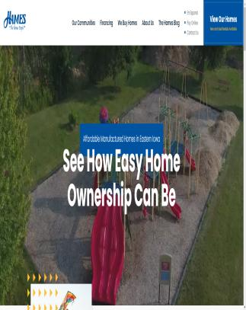
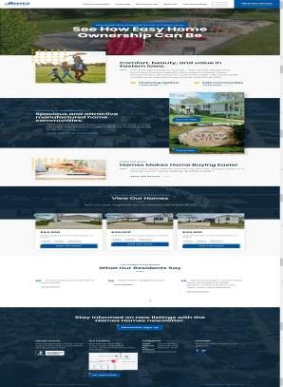
SCREENSHOTS OF WEBSITE
HOME PAGE

Slide 11
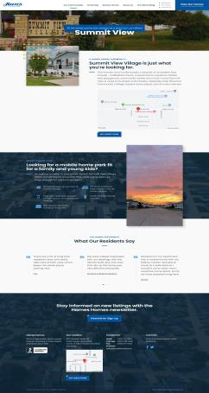
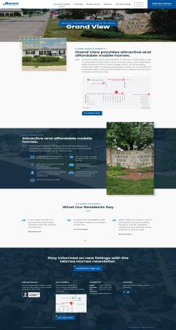
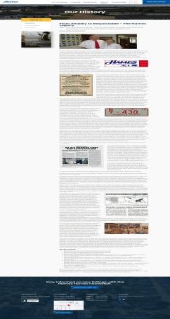
FEW GLIMPSES

Slide 12
THANK YOU

